Slide 1


Handleiding dino
A
B
A+B

Slide 2
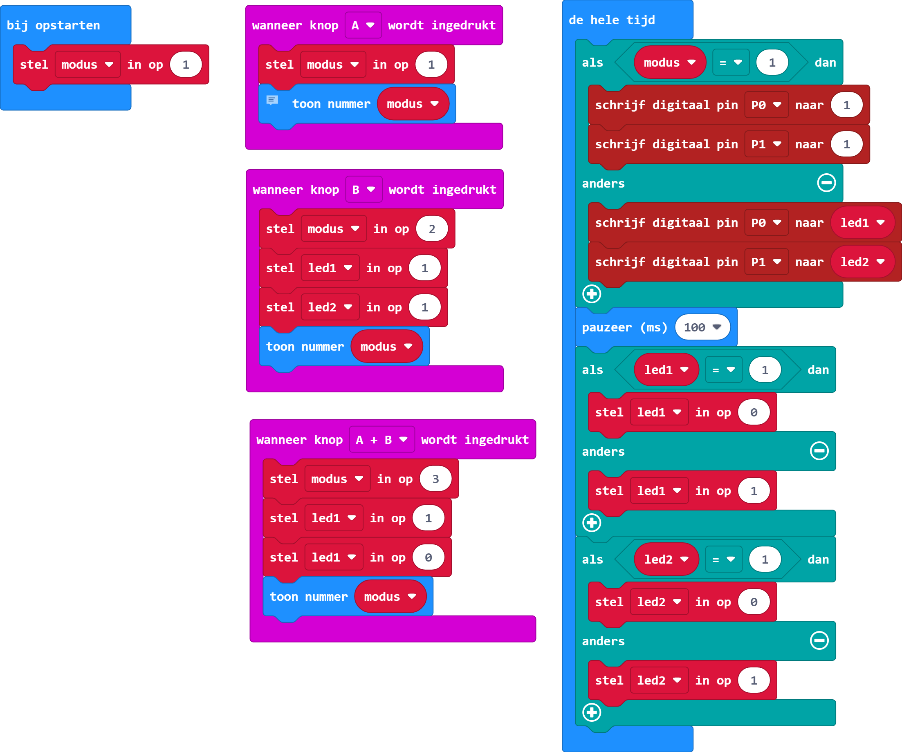
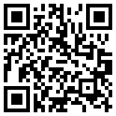
https://makecode.microbit.org/_aVyXKeExv3tT

